Slide 1
There is no R in Data Management
John Hinchy

Slide 2
Agenda
What is data management?
Why should R worry about data management?
How R helps with data management

Slide 3
What is data management?

Slide 4
Key elements of data management
Data Resource Management is the development and execution of architectures, policies, practices and procedures that properly manage the full data lifecycle needs of an enterprise.
(DAMA)
Ensemble of activities
Focused on data
Designed to gain, maximize, retain, reveal and share the information conveyed by the data
The value of data is in supporting better decision making through the provision of information
Data Management is a comprehensive collection of practices, concepts, procedures, processes, and a wide range of accompanying systems that allow for an organization to gain control of its data resources. Data Management as an overall practice is involved with the entire lifecycle of a given data asset from its original creation point to its final retirement, how it progresses and changes throughout its lifetime through the internal (and external) data streams of an enterprise.
(dataversity)
Data management refers to an organization's management of information and data for secure and structured access and storage.
Data management tasks include the creation of data governance policies, analysis and architecture; database management system (DMS) integration; data security and data source identification, segregation and storage.
(techopedia)
Data management is the practice of organizing and maintaining data processes to meet ongoing information lifecycle needs.
(TechTarget)
Administrative process by which the required data is acquired, validated, stored, protected, and processed, and by which its accessibility, reliability, and timeliness is ensured to satisfy the needs of the data users.
(BusinessDictionary)

Slide 5
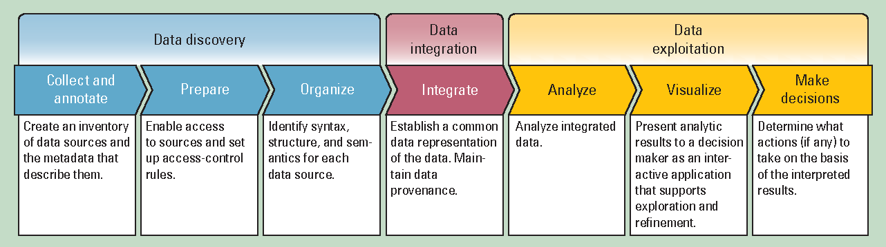

Data value chain
Ensemble of activities …
… gain, maximize, retain, reveal and share the information conveyed by data
The ensemble of activities are a value chain that captures then adds value to the data
Once added, the value is exploited and shared
R mostly plays in that space
Data to Decisions, Miller & Mork (2013)

Slide 6
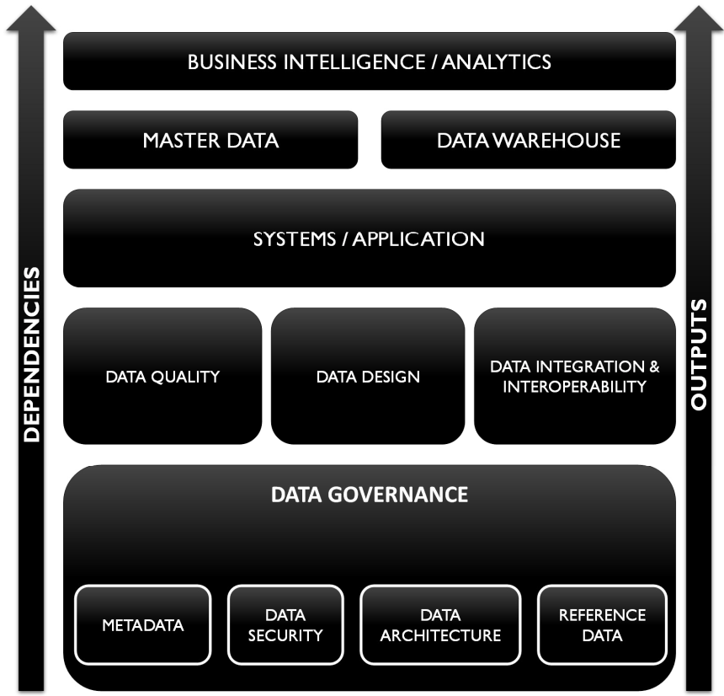
Data management: Planning and Execution
Value chain focuses on execution
Data management also includes
Governance & architecture: planning activities
Support activities: security, data design, etc.
Execution depends on the Governance and Support activities
Analytics and BI – R – rest on that layer

Slide 7
Why should R worry about data management?

Slide 8


Slide 9
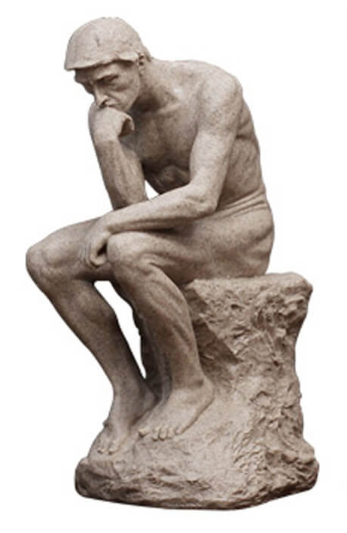
Why worry about data management?
1. Analysts are consumers of data and the quality of their work depends on the quality of the data they consume
2. As analysts we’re part of the data management community, we should be involved in all parts of our community

Slide 10
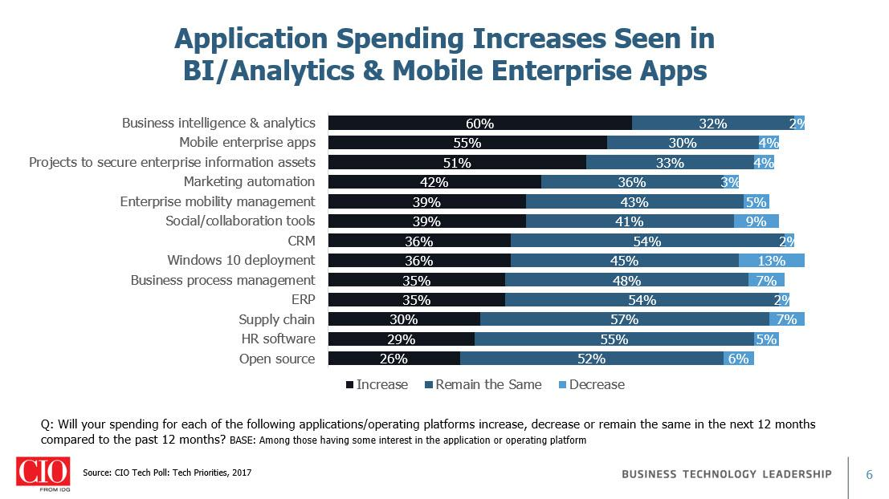
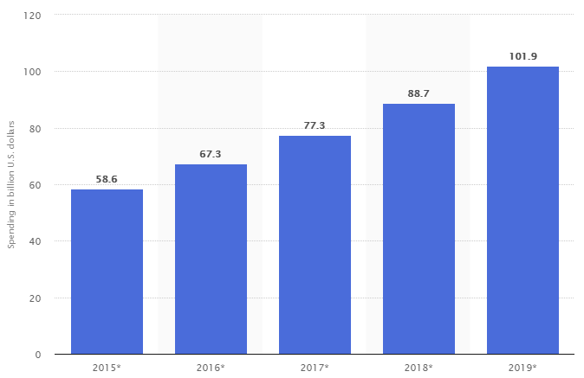
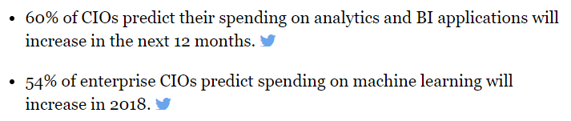
Business Analytics is the Focus
Term: Business + … | Results (x10⁶)
Analytics | 674
“big data” | 77
“business intelligence” | 52
“data analysis” | 71
“data warehouse” | 12
“master data management” | 7
“data governance” | 3
“data architecture” | 2
Data management is an ensemble of about 12 different discipline areas, but Analytics is the Big Time.
Forecast of business analytics services spending worldwide from 2015 to 2019 ($bn)
Tableau, IDG Research(2018)
Statista (2018)

Slide 11
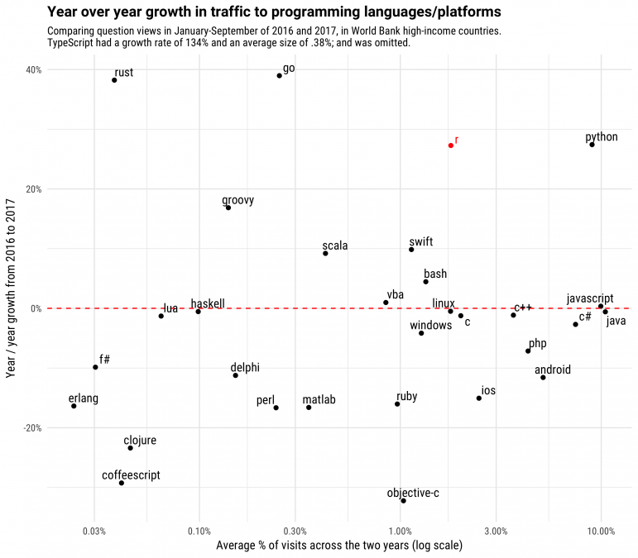
R is growing
R is one of the fastest growing languages
It is about equal in growth rate with Python
Although in absolute terms it trails Python
With Python, it is among the fastest growing languages supporting data analysis
Stackoverflow (2017)

Slide 12
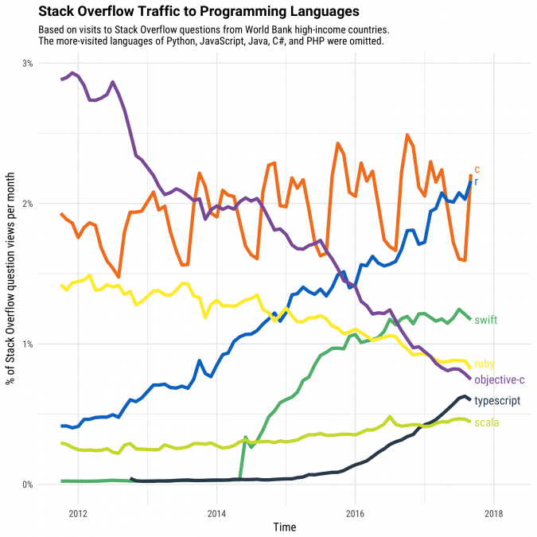
R is growing
R has sustained strong growth over the last five years unlike all other significant, similar-sized languages
Stackoverflow (2017)

Slide 13
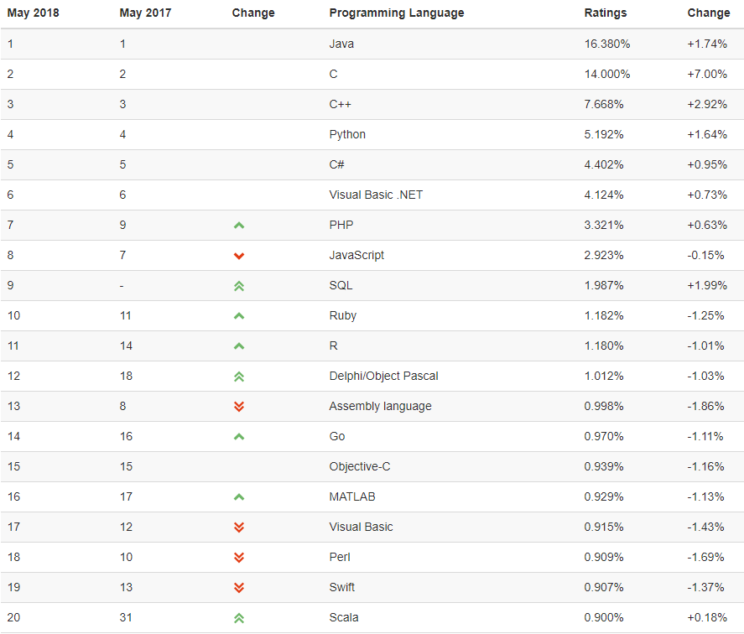
R is growing
R is the 11th most popular programming language
Behind Python (#4), (and behind SQL?) but ahead of other analytically-focused language (Julia, Fortran?, SAS, Scala, SPSS)
TIOBE (2018)

Slide 14
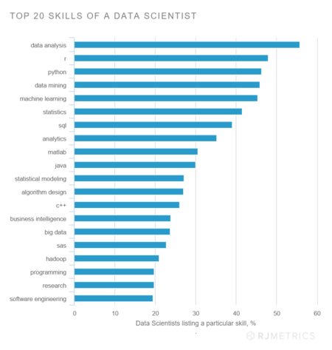
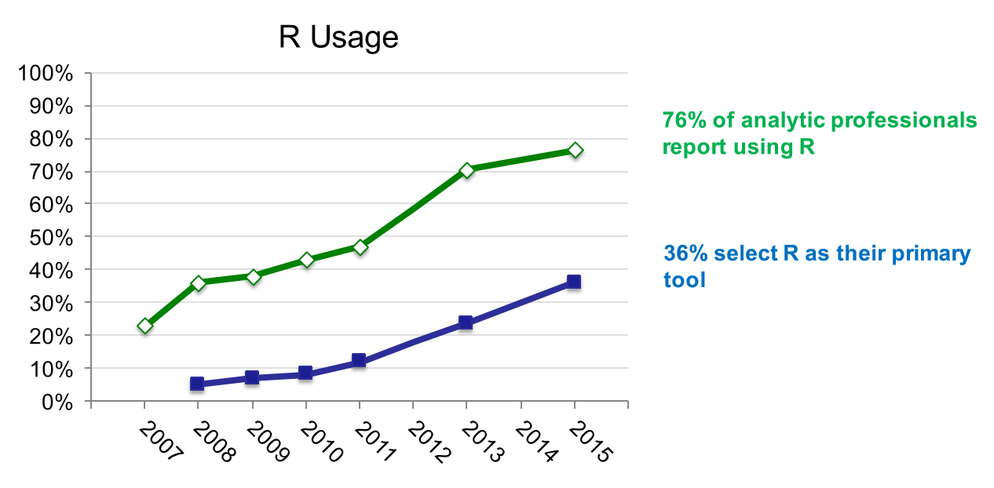
R is growing
R continues to grow in its user base in the data analytic community
12,600 library packages
LinkedIn, reported by RJmetrics (2016?)
Microsoft (2016)

Slide 15
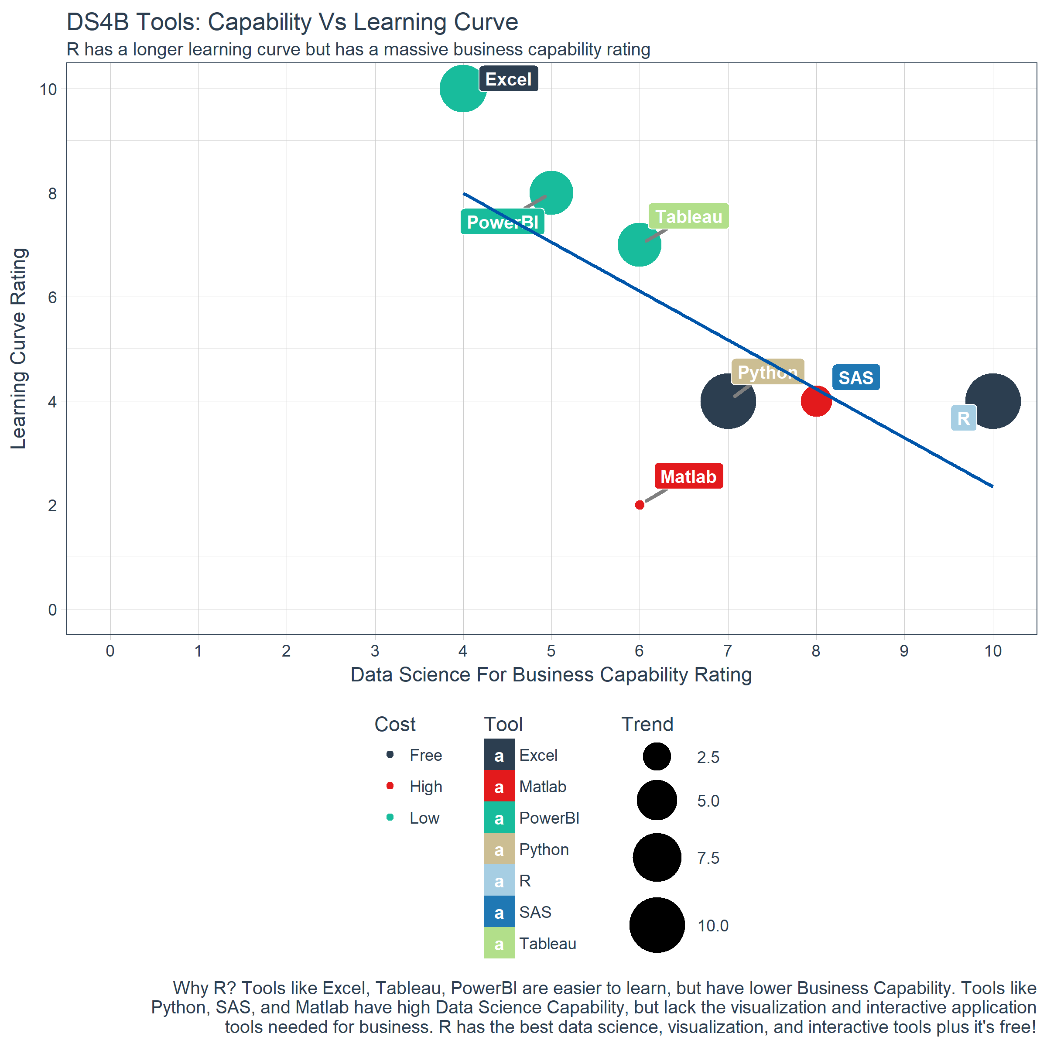
Data Analysis and R are mainstream
Data analysis is the face of data management in business
The growth of data sources and new analytic tools and techniques
R has become one of the main analytic platforms, including in business
Can deal with large amounts of data and distributed architectures (RevolutionR, ScaleR
Combination of price and power
Size of user community
Support for scalable report (e.g., Rmarkdown, Shiny)
Business Science (2017)

Slide 16
How R helps with data management

Slide 17
Data Analysis and R are mainstream … … with great power comes great responsibility

Slide 18


Slide 19
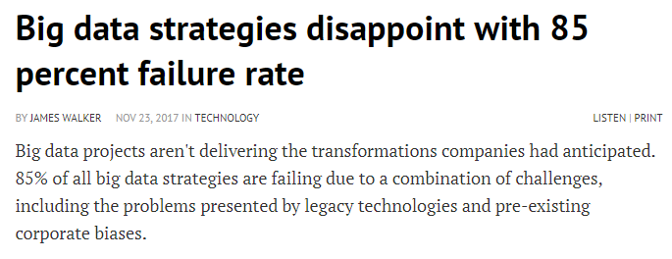

What could go wrong?
Lots
There is now plenty of evidence that data analysis projects, particularly big data projects, are far more likely to fail than not.
The often cited 60% failure rate reported by Gartner (2015), has been reported to be conservative estimate by its author, and is probably closer to 80%

Slide 20
What does go wrong?
Governance | Organization structure of data assets | 3
 | Organisation: structure of data skills | 1
 | No clear data strategy | 11
 | The Big Bang strategy | 3
 | No understanding of Big Data strategy | 1
 | Planning: No clear goals | 7
 | Planning: No support | 6
 | Planning: No voice of data | 1
 |  | 33
Data quality |  | 7
Data modelling |  | 1
Program Mgt | Overburdened management | 1
 | Not gathering requirements | 1
 | Documentation | 1
 |  | 3
Governance issues are top cause
Data skills and analytics including data quality are next most important
Data skills | Lack of sufficient skills | 7
 | No business focus | 3
 |  | 10
Failures of outcomes | Unrealistic expectations | 5
 | No ROI on outcome | 3
 | Lack of planning | 2
 | User acceptance | 6
 |  | 16
Analytics/DS | Poor analysis | 1
 | Poor data science | 1
 |  | 2
Technology | Wrong infrastructure | 2
 | Wrong architecture | 3
 | Old technologies | 3
 |  | 8
Based on ad hoc review of 11 recent reviews of what goes wrong with business data analysis projects citing 81 reasons
However, Data Quality is often identified as one of the most common causes

Slide 21
So how can R help?
Governance?
R can access a wide range of external data types, including relational databases through SQL, and cloud (e.g., AWS, Azure) although some work required – Structure of data assets
Most of the governance issues lie with the understanding what can or could be done using data – Realistic expectations
R can quickly test potential analytical outcomes to provide PoCs for more realistic feasibility assessment – Big Bang strategy
R’s support for accessible reporting (Shiny, plotting, etc.) makes results more available for non-technical audiences – Voice of data

Slide 22
So how can R help?
Package | Testing | Industry | Notes
dataQualityR | Variable | General | Variable-level checks for missing values, unique values, frequency tables, summary results.
validate | Dataset | General | Depends on the dataset; creates indicators of quality and reports performance of the dataset against the indicators
cleanEHR | Both | Clinical | Specific to clinical care datasets; missing data, out-of-range, invalid codes (clinical)
padr | Variable | General | DateTime data; identify breaks irregularities in time-polled data (and impute)
accrued | Dataset | Clinical | Public Health – surveillance: Checking quality of regularly polled data
datacheck | Variable |  | Visualisation tools (mostly) for checking against rules for valid data
divagis | Variable | Biology | Provides tools for quality checks of georeferenced plant species accessions
fdq | Both | Forestry | Forest Data Quality: focus on consistency, punctuality and completeness
Meth27QC | Dataset | Genomics | Meth27QC: sample quality analysis, and sample control analysis for data from GenomeStudio/BeadStudio software
MOQA | Variable | Epidemiology | Basic Quality Data Assurance for Epidemiological Research associated with the MOSAIC project
preprosim | Variable | General | Lightweight data quality simulations to test robustness of data analysis findings under various conditions (noise, outliers, missing data, etc.)
preproviz | Variable | General | Tools for visualization of interdependent data quality issues such as noise, outliers, missing data, etc. and investigation impact on decisions
qat | Variable | Meteorology | Quality assurance toolkit for use with netCDF-data formats. Provides extensive range of checks
RDIDQ | Variable | General | Performs basic quality check on data
StatMeasures | Variable | General | Easy data manipulation, data quality and basic statistical checks for use with dataframe and data.table
Data Quality – There are R packages specifically designed to assess data quality
Helps build a SOP around data quality assessment as part of any project – builds reproducible, maintainable checking for validity, reliability, completeness
Easy access to data sources and PoCs accelerate identification of needed data types
Base R provides sufficient tools for assessing basic quality metrics at the variable level.
There are various packages already built.

Slide 23
Conclusions
There is intense focus on data analysis – great expectations
At the same time, R has significantly moved into the mainstream
Therefore, the fates of data analysis and R are increasingly bound together
But, the track record of Data Analysis projects in business is not good
What is going wrong is complex, but two key factors are poor governance around analysis projects and poor data
R can help with both of these
Support for low-cost PoC tests to inform the governance process
Tools to easy the weight of DQ testing and the ability to make them SOP

